Slide 1
Introduction to Statistics

Slide 2
Overview
A common goal of surveys and other data collecting tools is to collect data from a smaller part of a larger group so we can learn something about the larger group.
In this section we will look at some of ways to describe data.

Slide 3
Definitions
Data
Observations (such as measurements, genders, survey responses) that have been collected.

Slide 4
Definitions
Statistics
A collection of methods for planning experiments, obtaining data, and then organizing, summarizing, presenting, analyzing, interpreting, and drawing conclusions based on the data.

Slide 5
Definitions
Population
The complete collection of all elements (scores, people, measurements, and so on) to be studied.
The collection is complete in the sense that it includes all subjects to be studied.

Slide 6
Definitions
Census
The collection of data from every member of the population.
Sample
  A sub-collection of elements drawn from a population.

Slide 7
Key Concepts
Sample data must be collected in an appropriate way, such as through a process of random selection.
If sample data are not collected in an appropriate way, the data may be so completely useless that no amount of statistical torturing can salvage them.

Slide 8

Types of Data

Slide 9
Definitions
Parameter
A numerical measurement describing some characteristic of a population
Population
A parameter is any summary number, like an average or percentage, that describes the entire population.
Parameter

Slide 10
Definitions
Statistic
A numerical measurement describing some characteristic of a sample.
sample
A statistic is any summary number, like an average or percentage, that describes the sample.
statistic

Slide 11
Definitions
Quantitative data
Numbers representing counts or measurements.
Example: Weights of supermodels.

Slide 12
Definitions
Qualitative (or categorical or attribute) data
Can be separated into different categories that are distinguished by some nonnumeric characteristics.
Example: genders (male/female) of professional athletes.

Slide 13
Working with
Quantitative Data
Quantitative data can further be distinguished between discrete and continuous types.

Slide 14
Definitions
Discrete
Data result when the number of possible values is either a finite number or a‘countable’ number of possible values.
0, 1, 2, 3, . . .
Example: The number of eggs that hens lay.

Slide 15
Definitions
Continuous
(numerical) data result from infinitely many possible values that correspond to some continuous scale that covers a range of values without gaps, interruptions, or jumps.
Example:
i. The amount of milk that a cow produces; e.g. 2.343115 gallons per day.
ii. Market price of a product
iii. the amount of time required to complete a project.

Slide 16
Levels of Measurement
Another way to classify data is to use use levels of measurement.
Four of these levels are discussed in the following slides.
CATEGORICAL: NOMINAL
CONTINOUS: ORDINAL, INTERVAL, RATIO

Slide 17
Definitions
Nominal level of measurement
characterized by data that consist of names, labels, or categories only. The data cannot be arranged in an ordering scheme (such as low to high)
Example: name of book, survey responses yes, no, undecided

Slide 18
Definitions
Ordinal level of measurement
involves data that may be arranged in some order, but differences between data values either cannot be determined or are meaningless
Example: Elementary school, High school, College, and University

Slide 19
Definitions
Interval level of measurement
like the ordinal level, with the additional property that the difference between any two data values is meaningful. However, there is no natural zero starting point (where none of the quantity is present)
Example: Years 1000, 2000, 1776, and 1492

Slide 20
Interval Scale
Very commonly used.
Used with the traditional 5-point scale (or 3-point, 7-point or 9-point) – Likert scale
I think the mobile phone is the greatest invention ever.
1
Strongly
Disagree
2
Disagree
3
Neutral
4
Agree
5
Strongly
Agree
The numbers indicate the value to be assigned to each possible answer, with 1 (least favourable) to 5 (most favourable) degree of agreement for the given statement above.

Slide 21
Definitions
Ratio level of measurement
the interval level modified to include the natural zero starting point (where zero indicates that none of the quantity is present). For values at this level, differences and ratios are meaningful.
Example: Prices of college textbooks ($0 represents no cost)

Slide 22
Summary -
Levels of Measurement
Nominal - categories only
Ordinal - categories with some order
Interval - differences but no natural starting point
Ratio - differences and a natural starting point

Slide 23
Definitions
Voluntary response sample
(or self-selected survey) – BAD SAMPLE
one in which the respondents themselves decide whether to be included.
In this case, valid conclusions can be made only about the specific group of people who agree to participate.

Slide 24
Misuses of Statistics
Bad Samples
Small Samples
Misleading Graphs

Slide 25
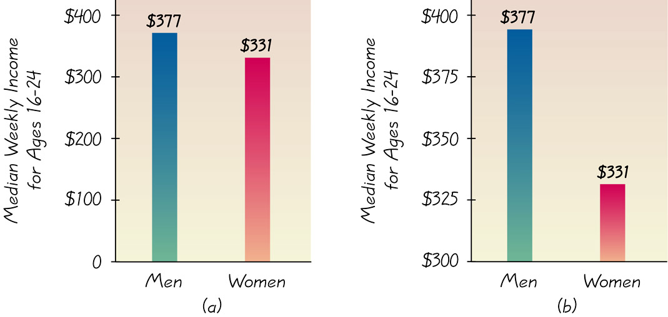
Misleading Graphs by just modifying the scale in Y-axis

Slide 26
To correctly interpret a graph, we should analyze the numerical information given in the graph instead of being mislead by its general shape.

Slide 27
Misuses of Statistics
Bad Samples
Small Samples
Misleading Graphs
Pictographs

Slide 28

Double the length, width, and height of a cube, and the volume increases by a factor of eight

Slide 29
Misuses of Statistics
Bad Samples
Small Samples
Misleading Graphs
Pictographs
Distorted Percentages
Loaded Questions

Slide 30
97% yes: “Should the President have the line item veto to eliminate waste?”
57% yes: “Should the President have the line item veto, or not?”

Slide 31
Misuses of Statistics
Bad Samples
Small Samples
Misleading Graphs
Pictographs
Distorted Percentages
Loaded Questions
Order of Questions
Refusals
Correlation & Causality
Self Interest Study
Precise Numbers
Partial Pictures
Deliberate Distortions

Slide 32
Design of Experiments

Slide 33
Major Points
If sample data are not collected in an appropriate way, the data may be so completely useless that no amount of statistical tutoring can salvage them.
Randomness typically plays a critical role in determining which data to collect.

Slide 34
Definitions
Observational Study
Observing and measuring specific characteristics without attempting to modify the subjects being studied

Slide 35
Definitions
Experiment
Apply some treatment and then observe its effects on the subjects

Slide 36
Definitions
Cross Sectional Study
  Data are observed, measured, and collected at one point in time.
Retrospective (or Case Control) Study
  Data are collected from the past by going back in time.
Prospective (or Longitudinal or Cohort) Study
  Data are collected in the future from groups (called cohorts) sharing common factors.

Slide 37
Controlling Effects
of Variables
Blinding
Subject does not know he or she is receiving a treatment or placebo
Blocks
Groups of subjects with similar characteristics
Completely Randomized Experimental Design
Subjects are put into blocks through a process of random selection
Rigorously Controlled Design
Subjects are very carefully chosen

Slide 38
Replication and
Sample Size
Replication
Repetition of an experiment when there are enough subjects to recognize the differences in different treatments
Sample Size
Use a sample size that is large enough to see the true nature of any effects and obtain that sample using an appropriate method, such as one based on randomness

Slide 39
Definitions
Random Sample
Members of the population are selected in such a way that each individual member has an equal chance of being selected
Simple Random Sample (of size n)
Subjects selected in such a way that every possible sample of the same size n has the same chance of being chosen

Slide 40
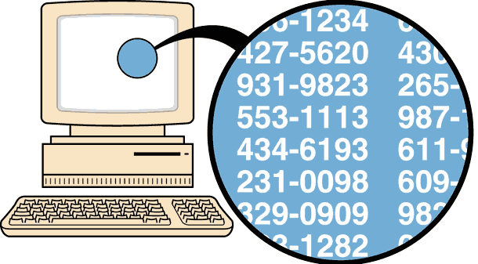
Random Sampling
Selection so that each has an
equal chance of being selected

Slide 41
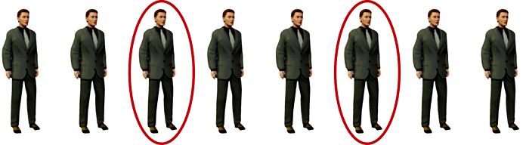
Systematic Sampling
Select some starting point and then
select every K th element in the population

Slide 42
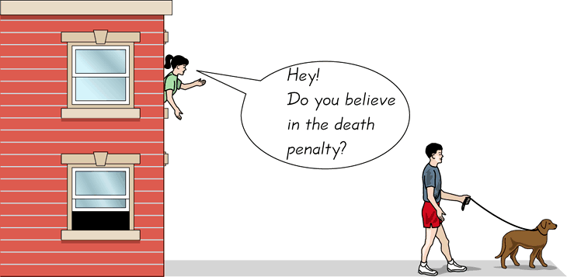
Convenience Sampling
Use results that are easy to get

Slide 43
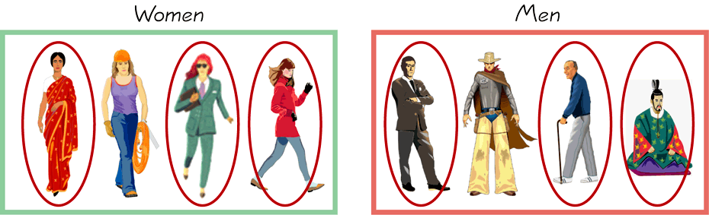
Stratified Sampling
Subdivide the population into at
least two different subgroups that share the same characteristics, then draw a sample from each subgroup (or stratum)

Slide 44
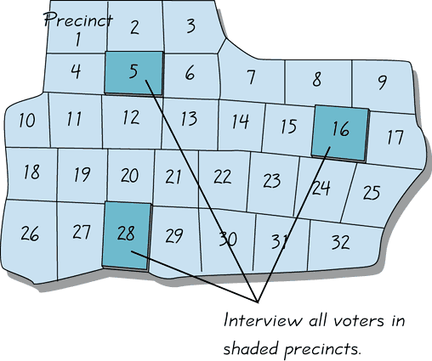
Cluster Sampling
Divide the population into sections
(or clusters); randomly select some of those clusters; choose all members from selected clusters

Slide 45
Methods of Sampling
Random
Systematic
Convenience
Stratified
Cluster

Slide 46
Instrumentation
The process of preparing to collect data is called instrumentation.
It involves the selection of the method by which data will be collected, as well as the procedures and conditions for collecting them

Slide 47
Examples of instruments
Questionnaire surveys
Interview questionnaires
Aptitude tests
Performance tests
Personality inventories …

Slide 48
Validity
Defensibility of the inferences a researcher can make from a study using an instrument
Reliability
Reliability refers to consistency of results. Does repeating it produce the same results?
Objectivity
The absence of subjective bias on the part of the researcher.
E.g. a supporter of a party may report different results

Slide 49
Ecological generalizability
External validity
The extent to which information can be generalized to a larger population is known as external validity.
This term refers to the degree to which a study can be generalized to a different set of conditions.
For example, researchers studying rural schools might have difficulty generalizing their results to urban schools.

Slide 50
END

